Slide 1
SPOT DETECTION IN X-RAY MEDICAL IMAGES
Submitted to Dr. Wang
Leons Manuel Saju - 1001620520
Goutham Munagala - 1001565060
Shivam Goyal - 1001667663

Slide 2
Outline
Introduction
Classification methods
Dataset description
Procedure & Experimentation
Results
Conclusion

Slide 3
Introduction
Aim: To accurately classify the number of dark spots in the X-ray images.
Purpose: ML technology has enabled many breakthroughs, which offer new approaches to solve complex problems without human interaction. We use it to overcome challenges in the surgical field.
Tools used: Matlab R2018b, Python 3.7.
Method used: Convolutional Neural Networks (CNN).

Slide 4
Classification methods
Supervised
Deep Neural Network
Convolutional Neural Network
Unsupervised
Data with no Class labels (Clustering)
Reinforcement
Training interactively by trial and error with feedback loops from its own actions and experiences.

Slide 5
Dataset description
Image format:
*.tiff images stack
*.csv with a description of the images.
An images stack is a succession of 24 x 24 pixels gray scale images extracted from the actual x-ray projection using a sliding window.
Dataset:
Training: 209,933 (30,000 for this project).
Testing: 30% of training data.
Data is composed of 48% of images without any spots, 48% of images with one spot and the last 4% are images containing 2 spots.

Slide 6
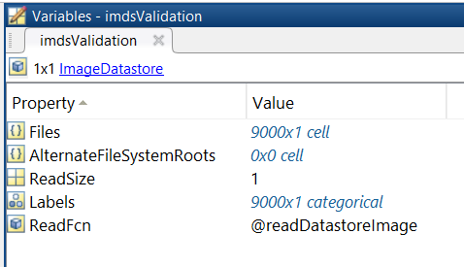
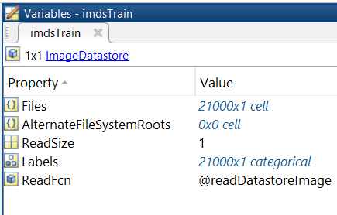
Dataset description

Slide 7
Procedure & experimentation
Image extraction from *.tiff
Input images into model
Training the model
Analyzing the result
Iterating over different options & convolution layers
Finding the best algorithm for the dataset
Results

Slide 8
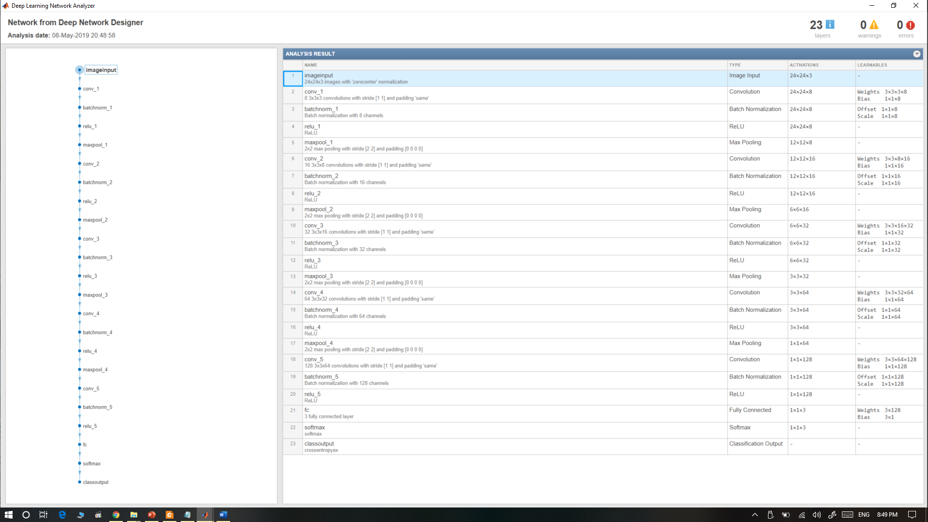
CNN design

Slide 9
CNN design

Slide 10
Results (MATLAB)
 | adam optimizer |  | sgdm optimizer |  | rmspro optimizer
Learning rate | Accuracy | Loss | Accuracy | Loss | Accuracy | Loss
.01 | 97.46 | .0923 | 97.69 | .0856 | 96.58 | .0815
.001 | 98.39 | .0651 | 96.86 | .1226 | 98.14 | .1056
.0001 | 95.24 | .1472 | 88.88 | .2740 | 95.38 | .1324

Slide 11
Results
Number of convolutional layers | Accuracy | Loss
1 | 86.78 | .3326
2 | 95.39 | .1292
3 | 98.39 | .0651
4 | 98 | .0478
5 | 98.89 | .0403

Slide 12
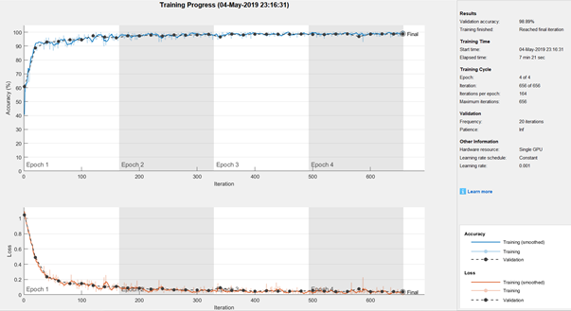
Results

Slide 13
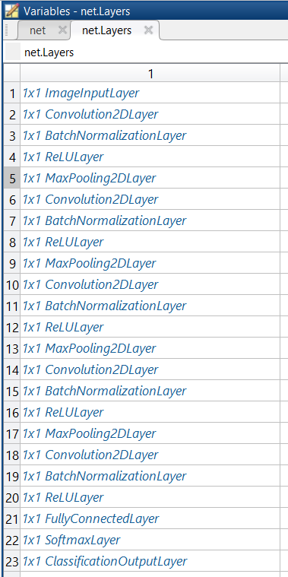
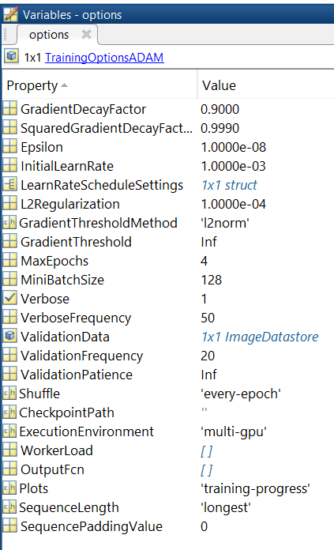
Layers and options used for the Best result

Slide 14
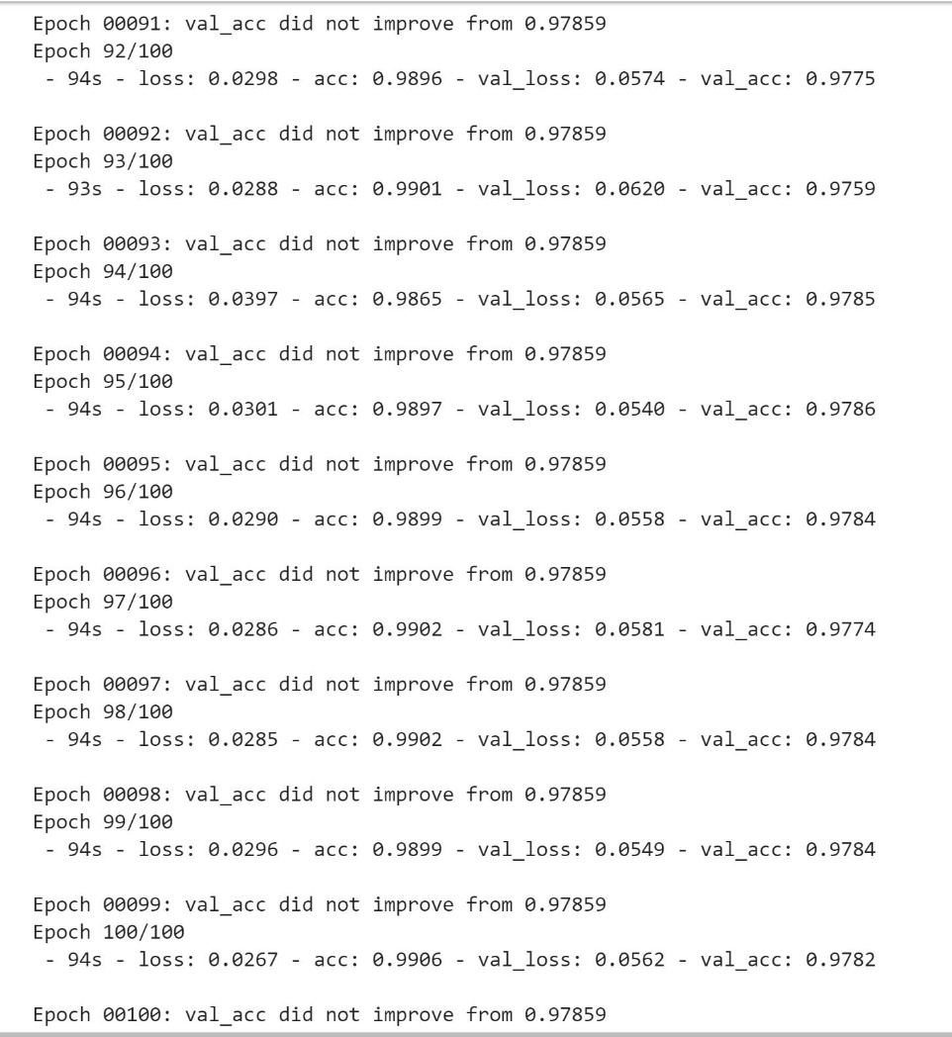
Results (PYTHON)

Slide 15
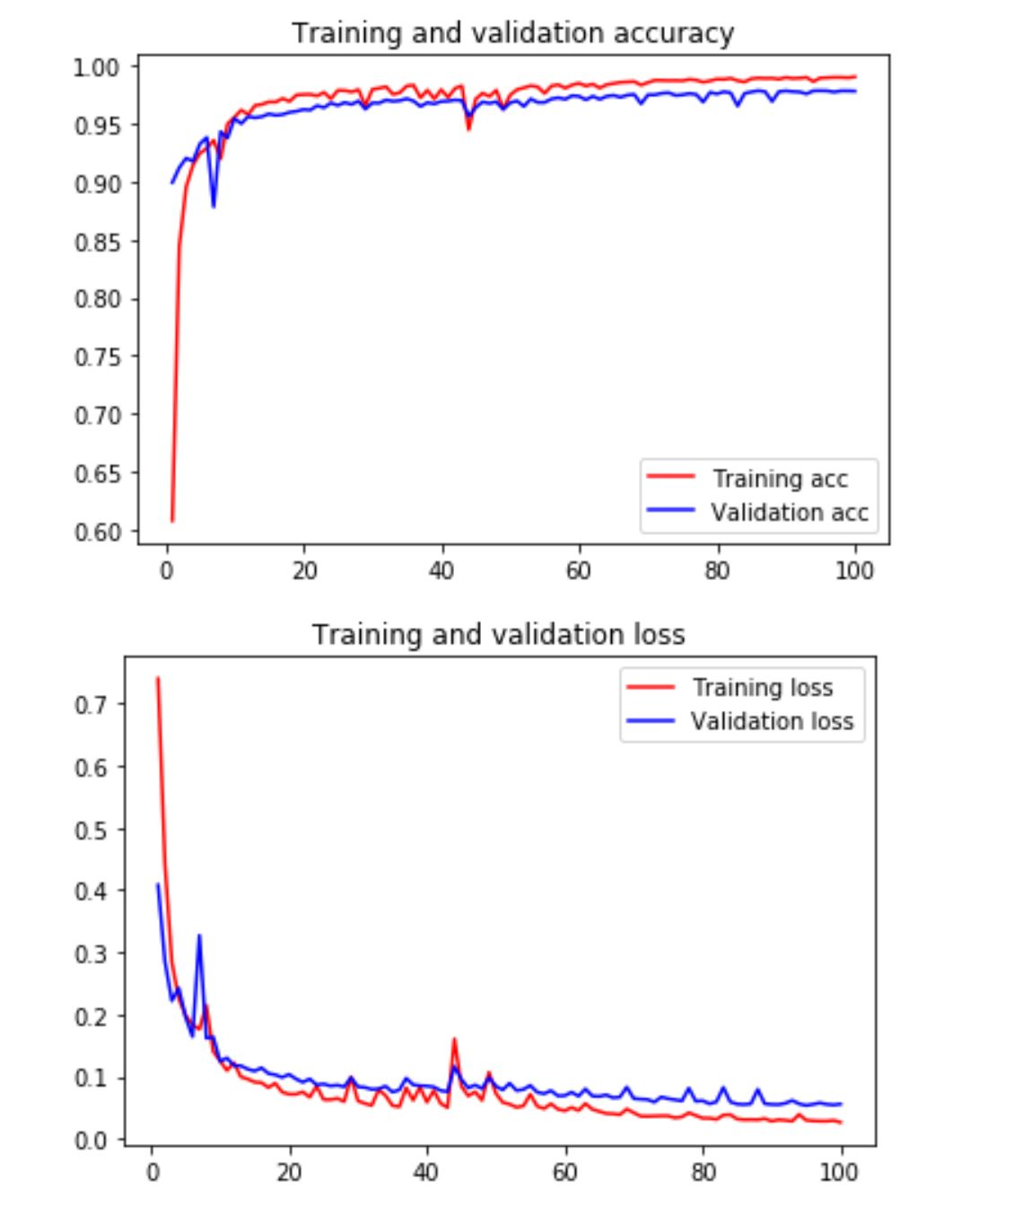
Results

Slide 16
Conclusion
Accuracy = 98.89%
Future scope: More work can be done on localizing the spots and finding their dimensions to have a clear picture of what's happening with the patient and realize how serious the circumstances are. This helps in a more timely and accurate treatment of the specific condition.

